Slide 1
Software Design & Architecture
Lecture # 07
Operation Contracts

Slide 2
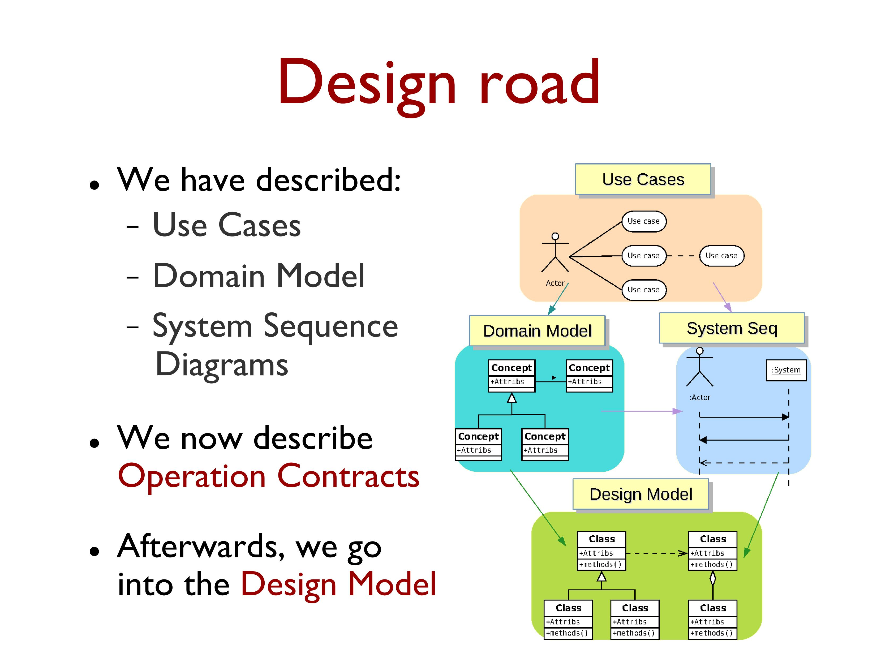
Design Road

Slide 3
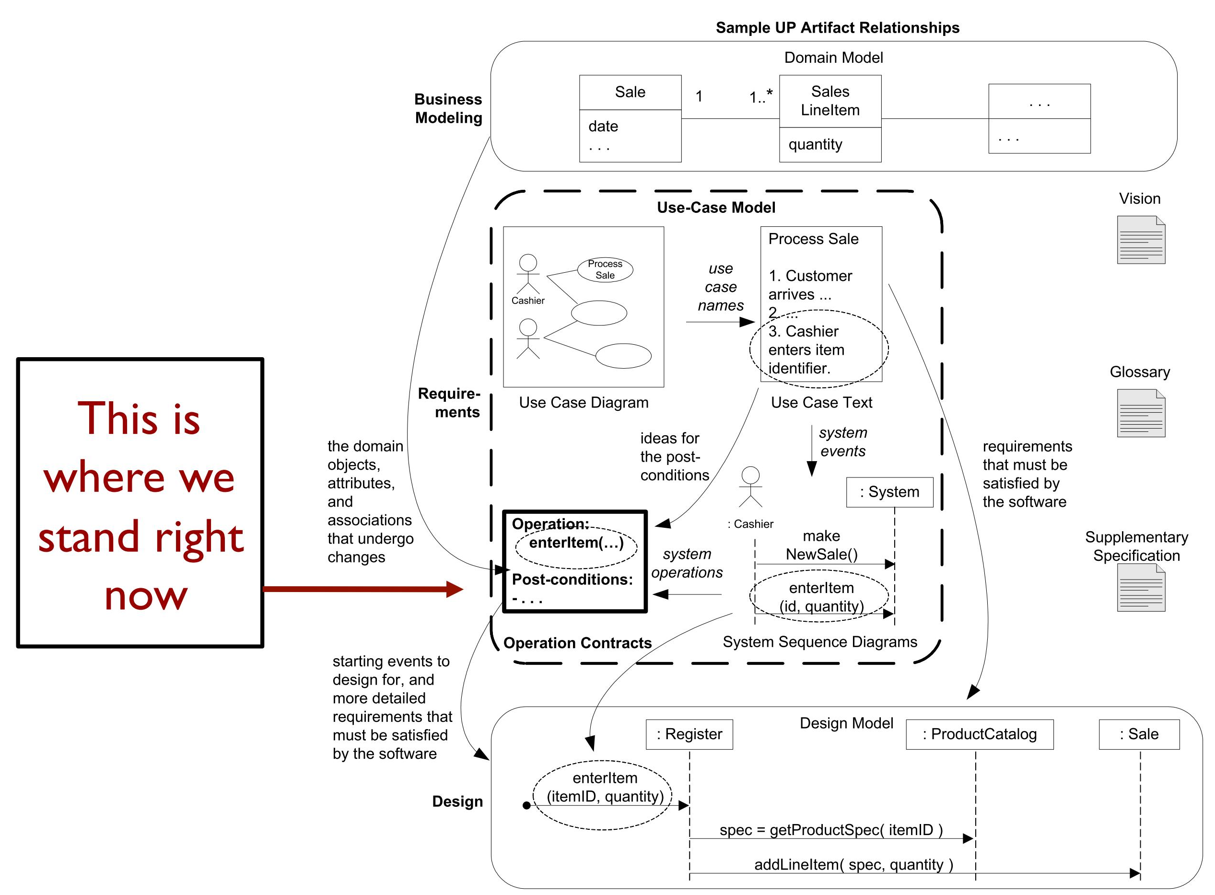
Design Road

Slide 4
Why Contracts?
Use cases are the primary mechanism in the UP to describe system behavior and are usually sufficient.
However, sometimes a more detailed description of system behavior has value.
Contracts for operations can help define system behavior.
Operation contracts use a pre- and post-condition form to describe detailed changes to objects in a domain model, as the result of a system operation.

Slide 5
Domain Model and Contracts
Domain Model is a visual representation of conceptual classes or real-world objects in the domain of interest.
Contracts describe detailed system behavior in terms of state changes to objects in the Domain Model, after a system operation has executed.

Slide 6
Keep it Agile
In many, or even most software development projects, operation contracts may be unnecessary.
For an agile process, use them only when necessary to add additional detail and understanding.

Slide 7
System Operations and the System Interface
Contracts may be defined for system operations
operations that the system as a black-box offers in its public interface to handle incoming system events.
System operations can be identified by discovering these system events.
The entire set of system operations, across all use cases, defines the public system interface, viewing the system as a single component or class.

Slide 8
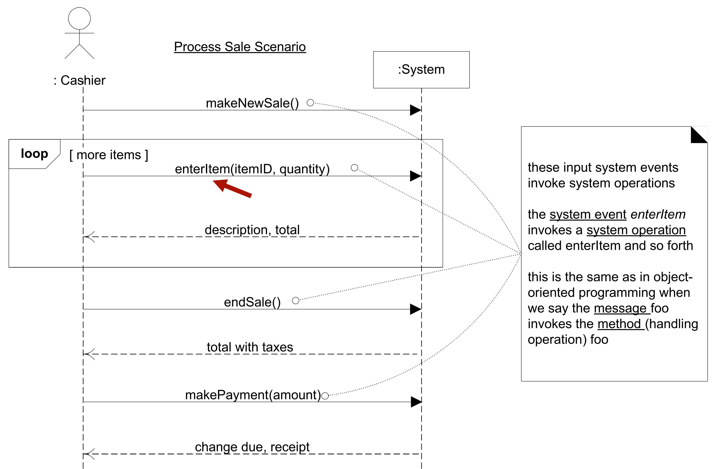
System Operations Handle Input System Events

Slide 9
Contract Sections
Operation: Name Of operation, and parameters.
Cross References: (optional) Use cases this can occur within.
Preconditions: Noteworthy assumptions about the state of the system or objects in the Domain Model before execution of the operation.
Postconditions: The state of objects in the Domain Model after completion of the operation.

Slide 10
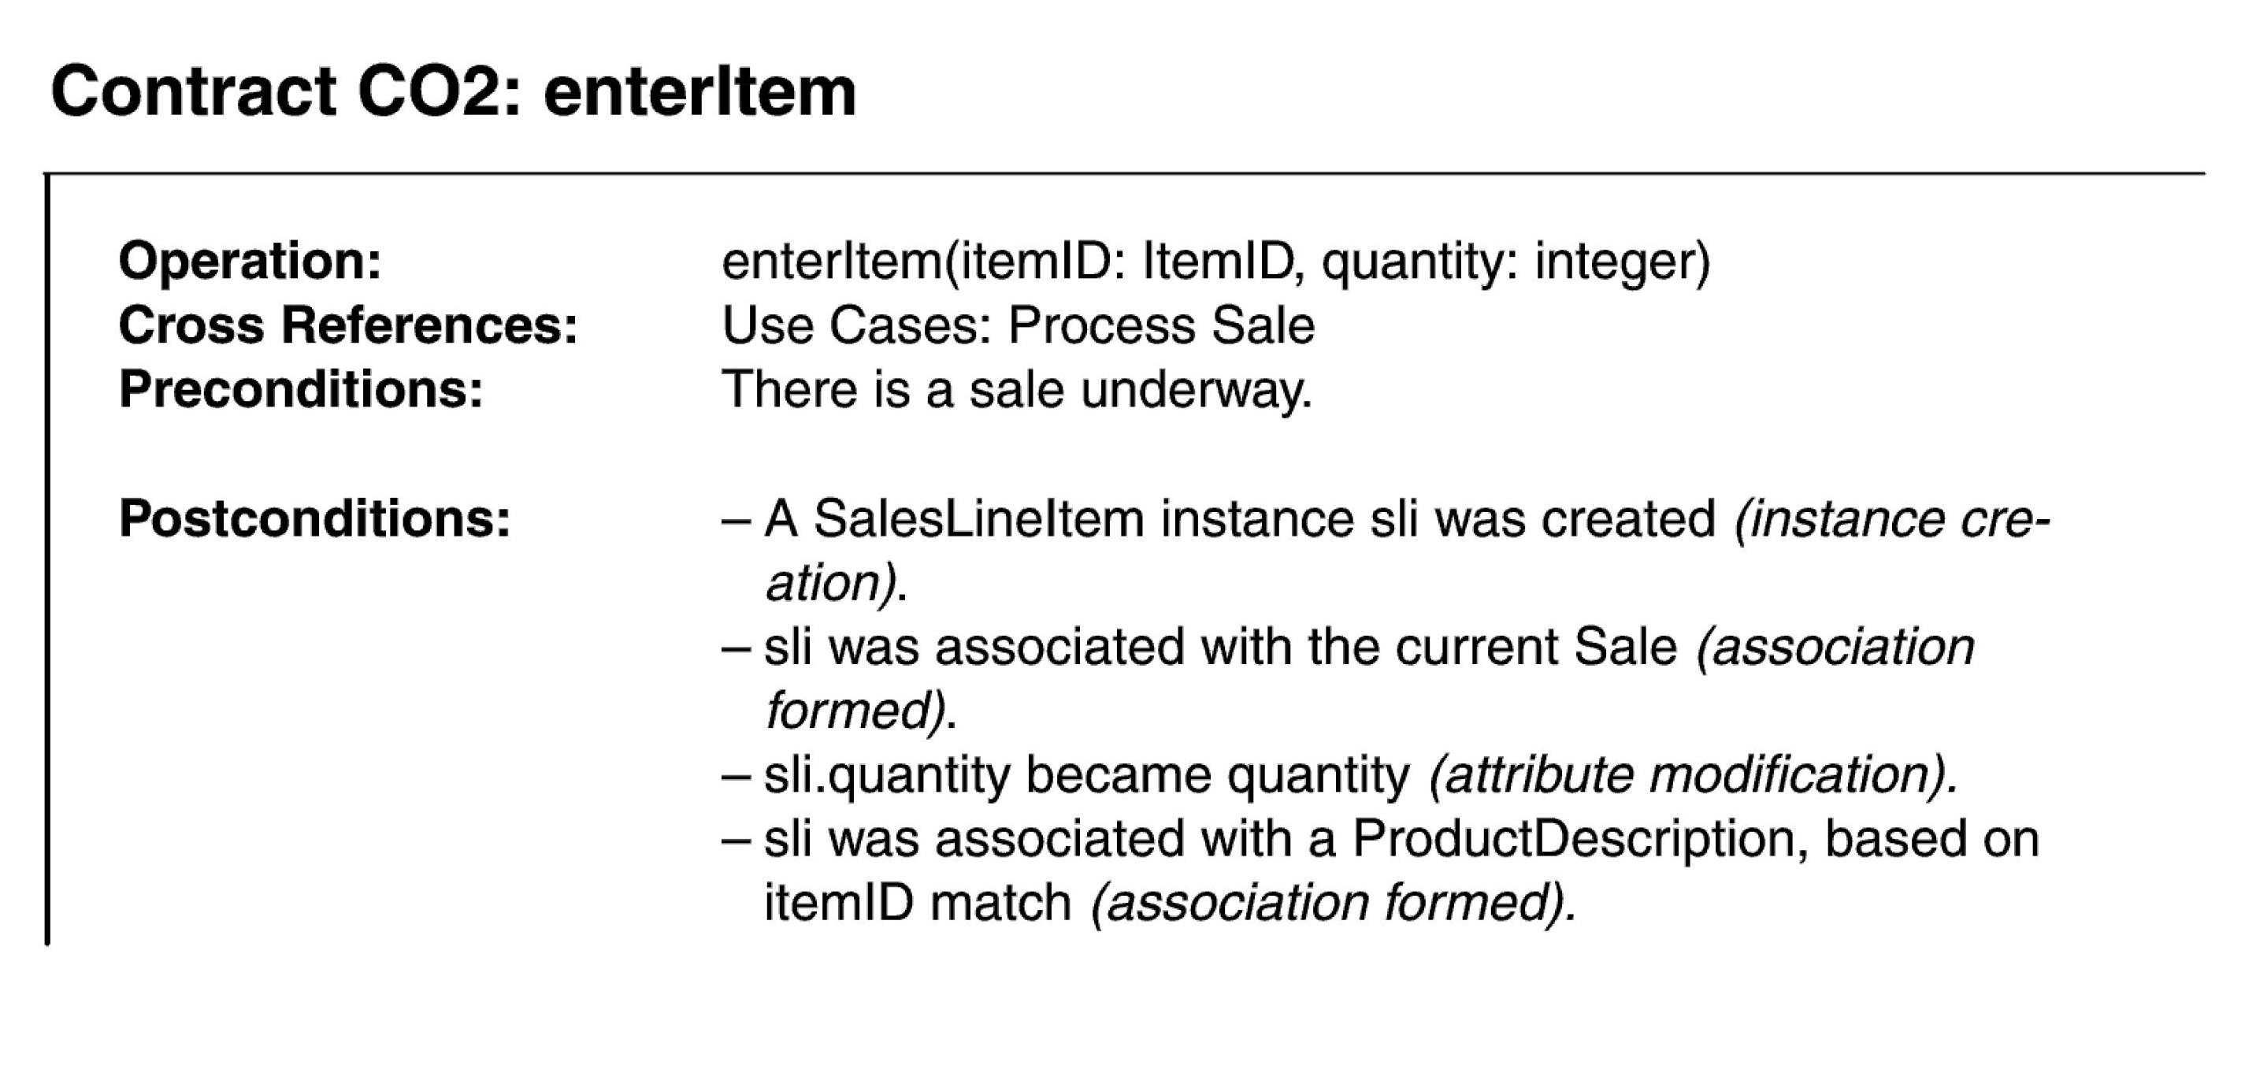
Example Contract: enterItem

Slide 11
Postconditions
The postconditions describe changes in the state of objects in the Domain Model. Domain Model state changes include instances created, associations formed or broken, and attributes changed.
Postconditions are not actions to be performed, during the operation; rather, they are observations about the Domain Model objects that are true when the operation has finished.

Slide 12
How to Write a Postcondition?
Express postconditions in the past tense, to emphasize they are observations about a state change in the past.
(better) A SalesLineItem was created.
(worse) Create a SalesLineItem.

Slide 13
The Spirit of Post-Conditions: The Stage and Curtain
Think about post-conditions using the following image:
The system and its objects are presented on a theatre stage.
Before the operation, take a picture of the stage.
Close the curtains on the stage, and apply the system operation
Open the curtains and take a second picture.
Compare the before and after pictures, and express as postconditions the changes in the state of the stage.

Slide 14
Writing Contracts Leads to Domain Model Updates
New conceptual classes, attributes, or associations in the Domain Model are often discovered during contract writing.
Enhance the Domain Model as you make new discoveries while thinking through the operation contracts.

Slide 15
When are Contracts Useful?
The use cases are the main repository of requirements for the project. They may provide most or all of the detail necessary to know what to do in the design.
If the details and complexity of required state changes are awkward or too detailed to capture in use cases, then write operation contracts.

Slide 16
When are Contracts Useful?
If developers can understand what to do based on the use cases and ongoing (verbal) collaboration with a subject matter expert, avoid writing contracts.
Operation contracts are uncommon.
If a team is making contracts for every system operation:
the use cases are poorly done, or
there is not enough collaboration or access to a subject matter expert, or
the team is doing too much unnecessary documentation

Slide 17
How to Create and Write Contracts
To make contracts:
Identify system operations from the SSDs.
For system operations that are complex and perhaps subtle in their own results, or which are not clear in the use case, construct a contract.
To describe the post-conditions, use:
instance creation and deletion
attribute modification
associations formed and broken

Slide 18
The Most Common Mistake In Creating Contracts
The most common problem in creating contracts is forgetting to include the forming of associations.
Particularly, when new instances are created, it is very likely that associations to several objects need be established.
Don’t forget to include all the associations formed and broken.

Slide 19
System Operations of the Process Sale Use Case
Contract CO1: makeNewSale
Operation: makeNewSale()
Cross References: Use Cases: Process Sale
Preconditions: none
Postconditions: - A Sale instance s was created (instance creation)
- s was associated with a Register (association formed)
- Attributes of s were initialized.

Slide 20
System Operations of the Process Sale Use Case
Contract CO3: endSale
Operation: endSale()
Cross References: Use Cases: Process Sale
Preconditions: There is a Sale Underway.
Postconditions: - Sale.isComplete became true (attribute modification)
Sale
A change to the
Domain Model
isComplete: Boolean
dateTime

Slide 21
System Operations of the Process Sale Use Case
Contract CO4: makePayment
Operation: makePayment( amount: Money )
Cross References: Use Cases: Process Sale
Preconditions: There is a Sale Underway.
Postconditions: - A Payment instance p was created (instance creation)
- p.amountTendered became amount (attribute modification)
- p was associated with the current Sale (association formed)
- The current Sale was associated with the Store (association formed); (to add it to the historical log of completed sales)

Slide 22
Recommended Reading
Chapter # 11: Operation Contracts from Applying UML and Patterns: An Introduction to Object-Oriented Analysis and Design and Iterative Development by Craig Larman, 3rd Edition

